Slide 1
A step-by-step guide to installing Windows 10
Instructor: Ms. HAFSA ZAHRA
Date: 23-03-2020

Slide 2
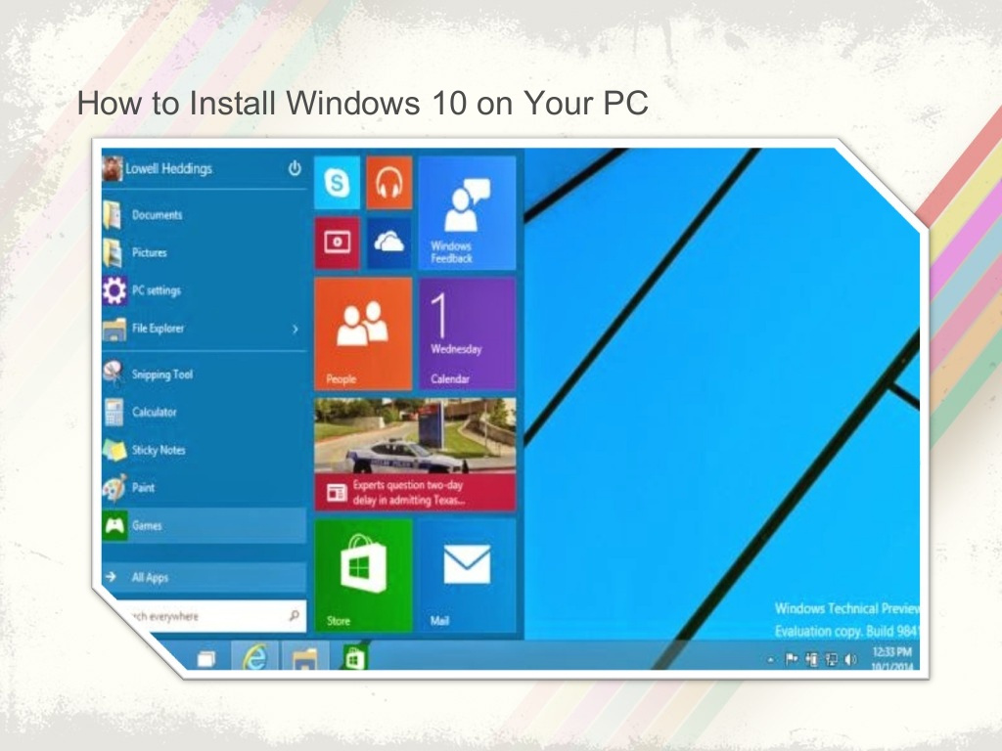

Slide 3
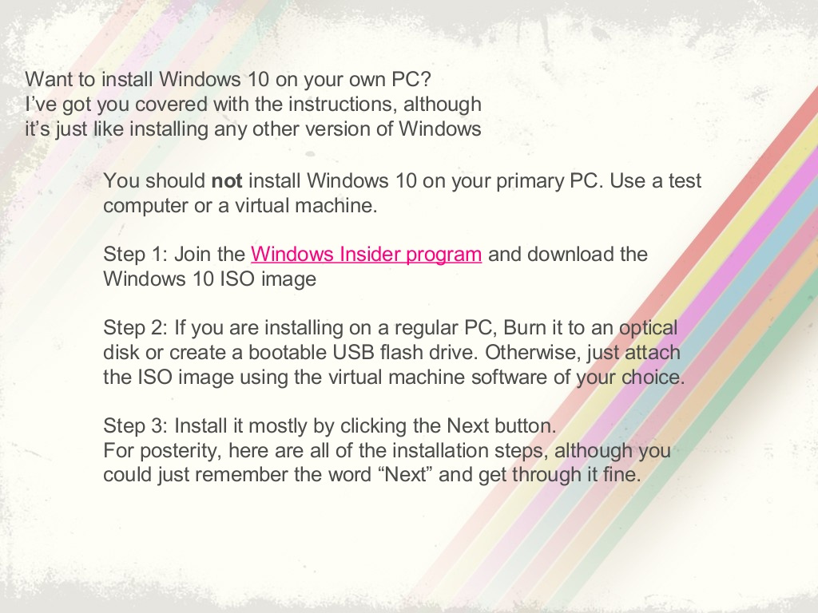

Slide 4
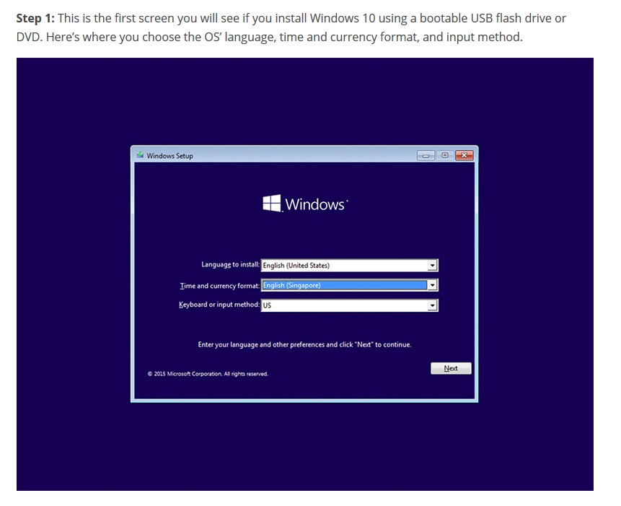

Slide 5
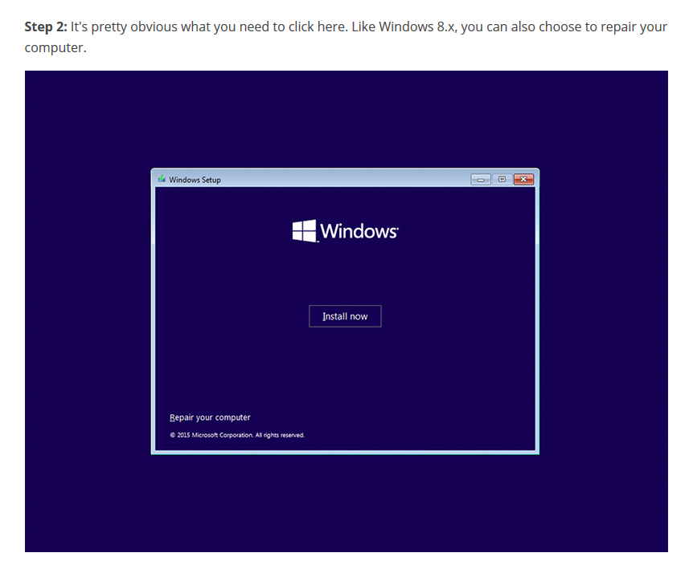

Slide 6
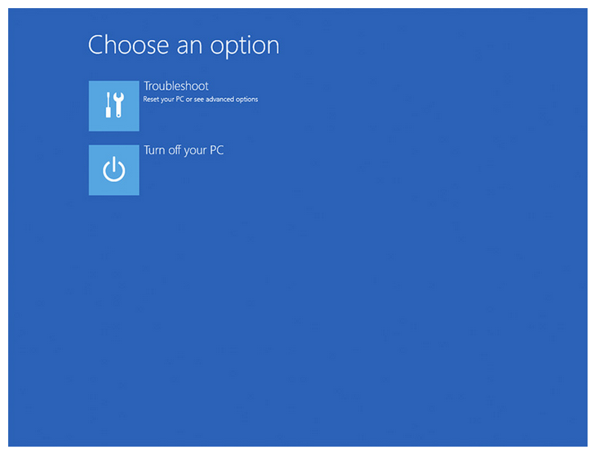
1. If you choose the repair option, you will end up at a troubleshoot screen where you can choose to reset your PC and re-install windows or access more advanced troubleshooting options. 2. For the latter, there are options for doing a system restore (if you’ve a restore point on your PC), image recovery, running commands in command prompt, and letting windows fix any startup problems. 3. You can also get to the advanced startup options after installation via the New settings app in Windows 10

Slide 7
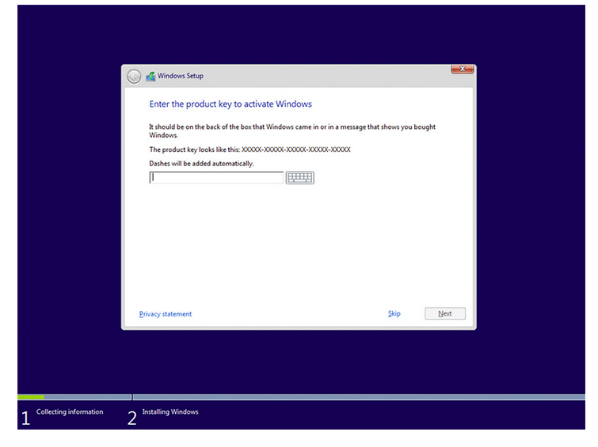
Step 3: Traditionally, your Windows product key can be found on your online order info, in the confirmation email for your purchase, or on the DVD package ng. That said, this is more for a clean install.
If your device has been successfully upgraded to Windows 10, and you choose to wipe your device and do a clean install later, the device will reactivate without the need of a Windows 8.x product key.

Slide 8
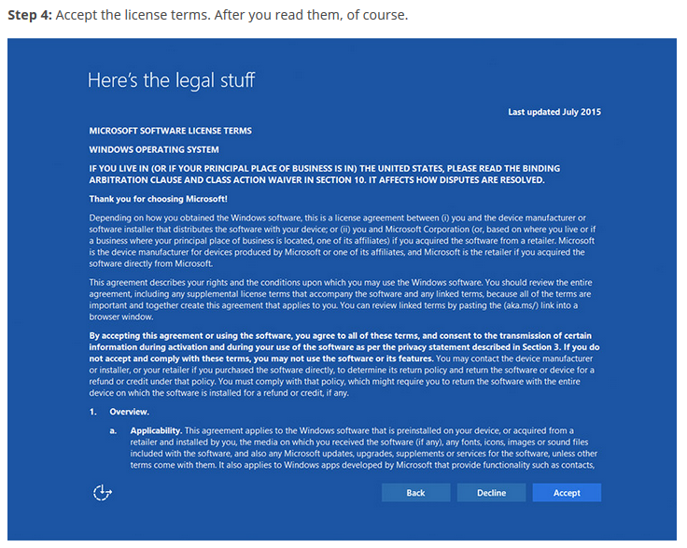

Slide 9
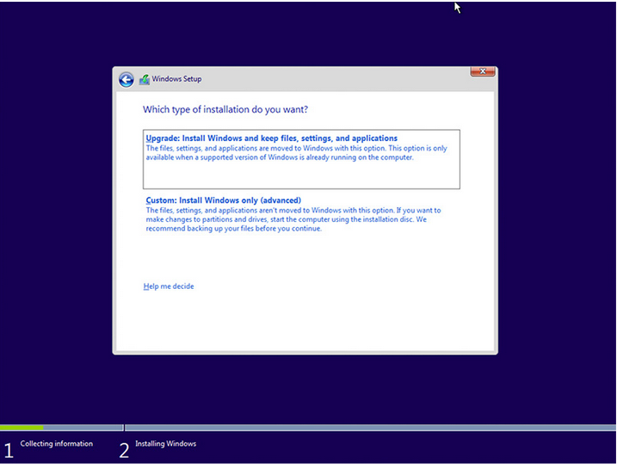
Step 5: Next, you’ll be presented with this screen, where you can choose to do either an upgrade (files, settings, and apps are moved to windows) or a custom install (files, settings, and apps aren’t moved). The latter is the one to choose if you prefer a clean install, which was what we did. (Note: if you're doing an upgrade, and you're running windows media center, windows 10 will remove it.)

Slide 10
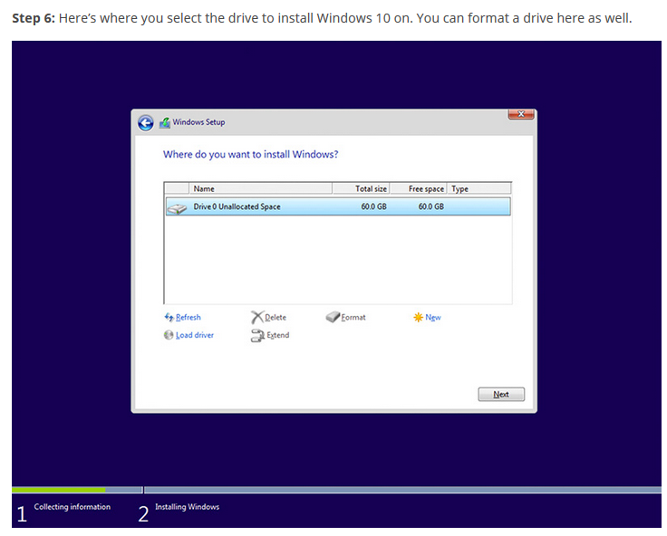

Slide 11
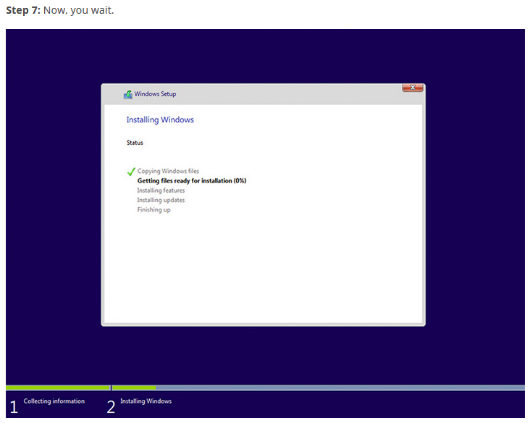

Slide 12
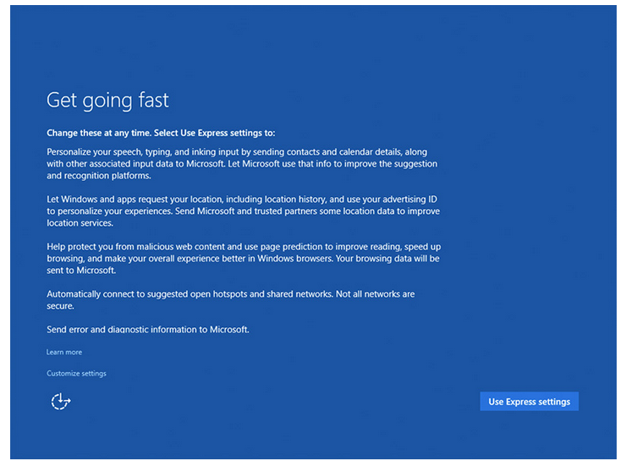
Step 8: Before you can start using Windows, there are some personalization, location, browser and protection, and connectivity and error reporting settings that you can adjust.
You can zip through all these by using the Express settings, which basically turn everything on, or you can hit the small print that says ‘Customize settings’ to customize them. We went for the latter

Slide 13
Remaining steps (from step 9) can be followed by using shared link:
https://www.hardwarezone.com.my/feature-heres-step-step-guide-installing-windows-10

